Slide 1
MEMORY PUZZLE GAME
GROUP MEMBERS :-
N. SANDEEP (103)
K.JAYANTH KUMAR(074)
G. SANDEEP(102)

Slide 2
ABSTARCT
This project in python language of Memory Puzzle is a simple console based GUI application using pygame module
In the Memory Puzzle game, several icons are covered up by white boxes. There are two of each icon. The player can click on two boxes to see what icon is behind them. If the icons match, then those boxes remain uncovered. The player wins when all the boxes on the board are uncovered. To give the player a hint, the boxes are quickly uncovered once at the beginning of the game.

Slide 3
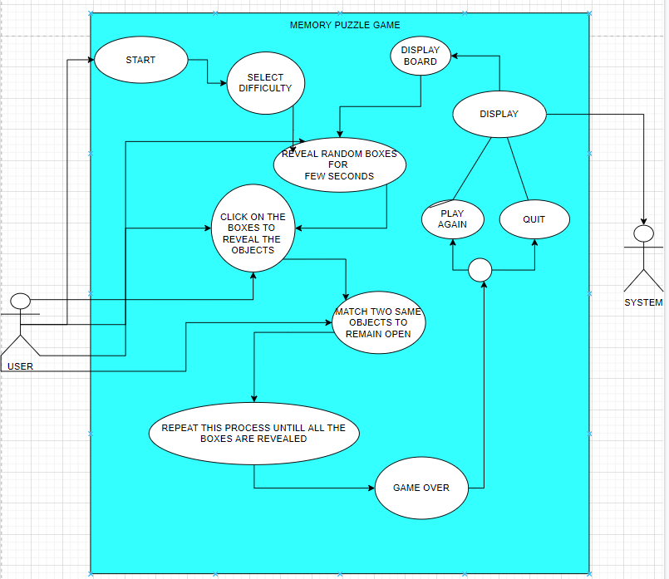
USE CASE DIAGRAM

Slide 4
TECHNOLOGY USED
Hardware Requirements:
Minimum Ram required: 512 mb
Minimum Disk Space required: 50 mb
Processor: core i3
Input devices: Mouse
Output devices: Monitor
Software Requirements:
IDLE Python (3.8 32 bit)
Python Launcher
Windows 8.1 or above
Modules used:
pygame module
random
Time

Slide 5
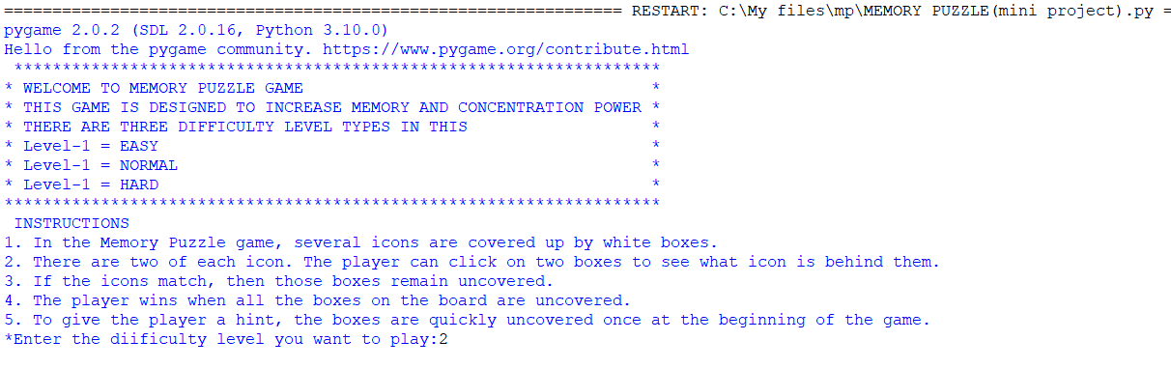
INSTRUCTIONS AND CHOOSING DIFFICULTY

Slide 6
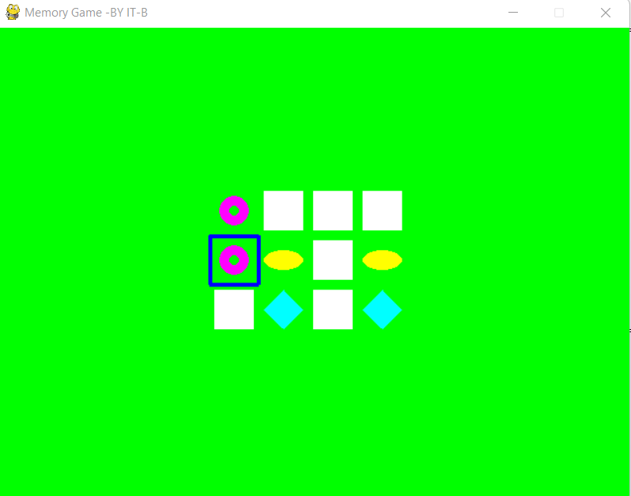
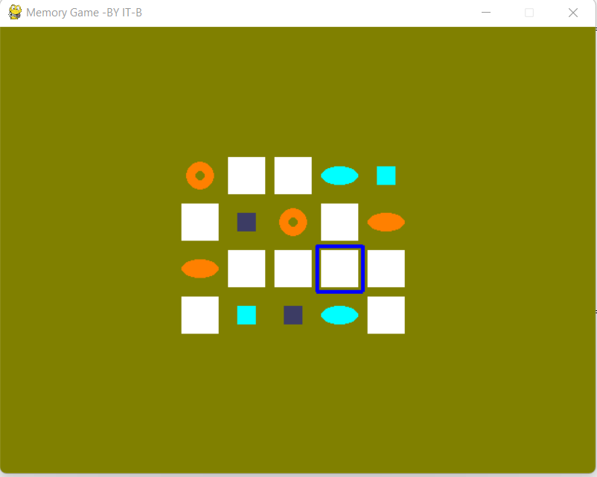
GAME PLAY - LEVEL 1,2

Slide 7
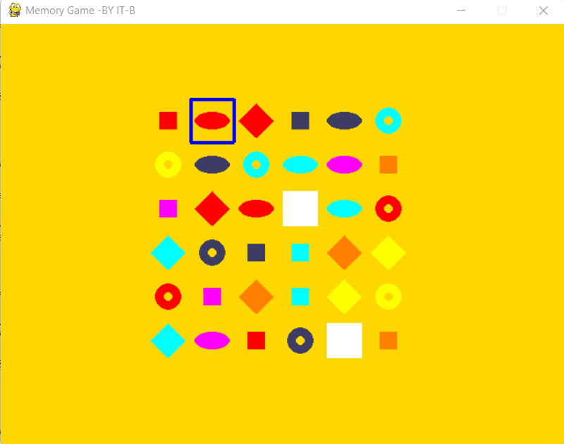
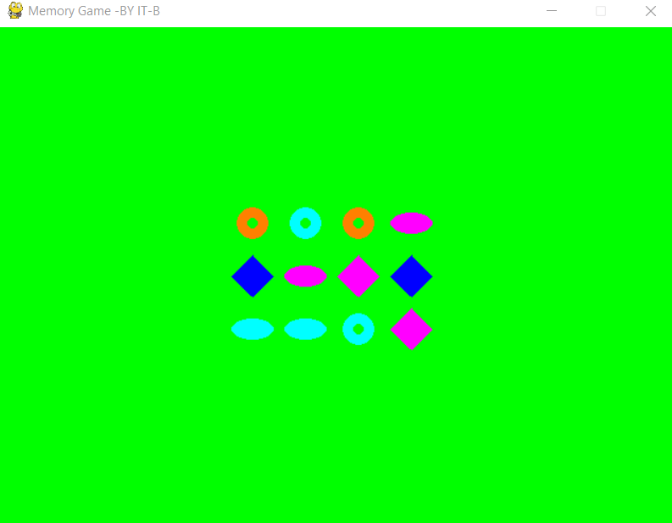
GAME PLAY - LEVEL 3, GAME WON

Slide 8
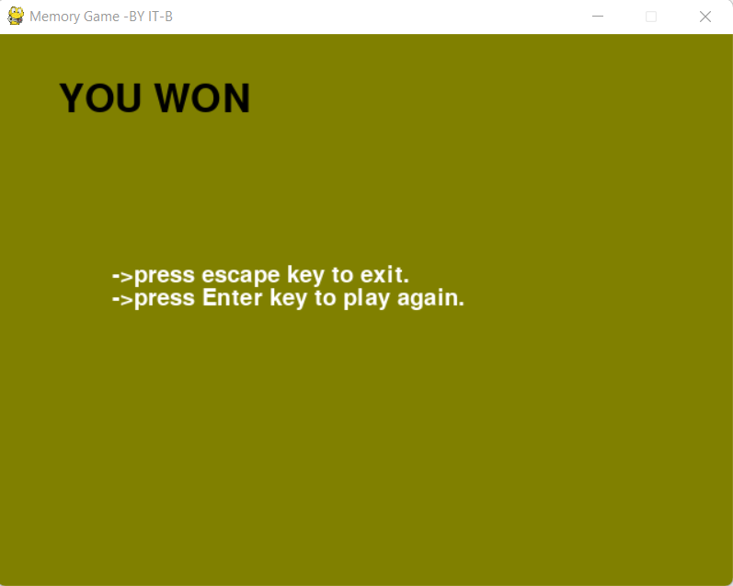
END MENU

Slide 9
CONCLUSION AND FUTURE WORK
This project in python language of Memory Puzzle is a simple console based GUI application. this project also gives us an idea of how we can use the random module and the pygame module to create GUI application with less effort and encourage us to create many more interesting projects.
FUTURE WORK :
Our project will implement in future after making some changes and modifications that can be done in our project are:
We can add more options like time, number of attempts, score based on the time and number of attempts, background music.
We can also include multi player in this and can calculate both the scores.

Slide 10


